Slide 1
Team Five Project Report
Covid-19 Exploratory Analysis
Project Presentation
AIT 580 Team Project
Spring 2021

Slide 2


Team 5 Organization
Tools
GitHub as our development resource to preserve code
Google Drive for collaboration and file storage
RapidMiner, Python, and R to complete modelling and statistical analysis
Python Packages included: NumPy, Pandas, SciPy, Matplotlib, Statistics
Project Goals:
We looked at infection rates before and after mask mandates
To track COVID-19 cases and deaths in the United States, showing the rapid spread of the disease and highlighting the effects of different state response strategies
Kane
van Doorn
Developer
Lorenzo Rollhauser
Developer

Slide 3
Agenda
Introductions
Background
Problem Statement
Risks/Assumptions
Datasets attributes and Data conditioning
Research
Analytics & Visualizations
Analytics & Visualizations
Findings
Summary
Future Work
Questions & Answers

Slide 4


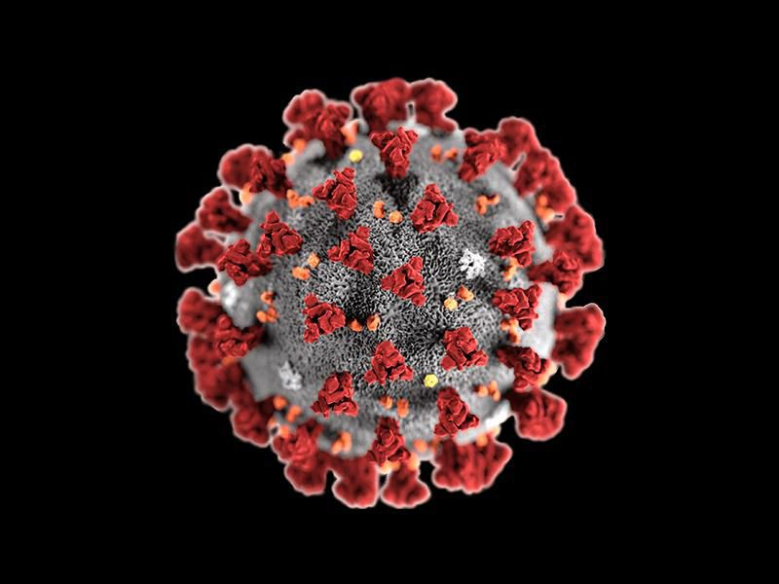

Data Sources
Centers For Disease Control and Prevention
United States COVID-19 Data
United States Census Bureau
United States Population Estimates

Slide 5
Background and Timeline
January 2020
First case of COVID-19 is confirmed in Wuhan, China and United States
April 2020
New Jersey becomes first state to pass a mask mandate
June 2020
Cases in the United States reach the two million mark
March 2020
Covid-19 is declared a pandemic by WHO
May 2020
Deaths in the United States pass 100,000 people
December 2020
Vaccinations are first made available to the general public

Slide 6
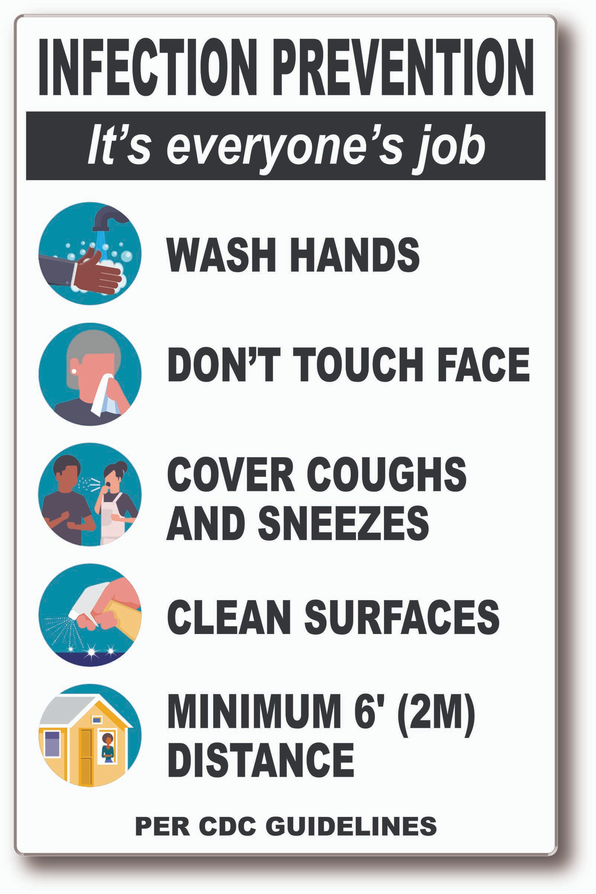

Problem Statement
Using the COVID-19 dataset from Center for Disease Control, our team intends to determine which variables of state responses affect the spread of the virus

Slide 7
Research, Analytics, and Algorithms
Moving Average
Useful for forecasting long term trends
Builds average based on previous data points to help create interpolations
Exploratory Data Analysis
Determines the prominent and underlying characteristics of datasets
Aids in creating data visualizations
04
01
COVID-19
Dataset
03
Classification
Cleaning unorganized unstructured or structured data
Helps make data more accessible
Exponential Smoothing
More advanced moving average that assigns weights to data points
Developing forecasts based on past observations
02

Slide 8
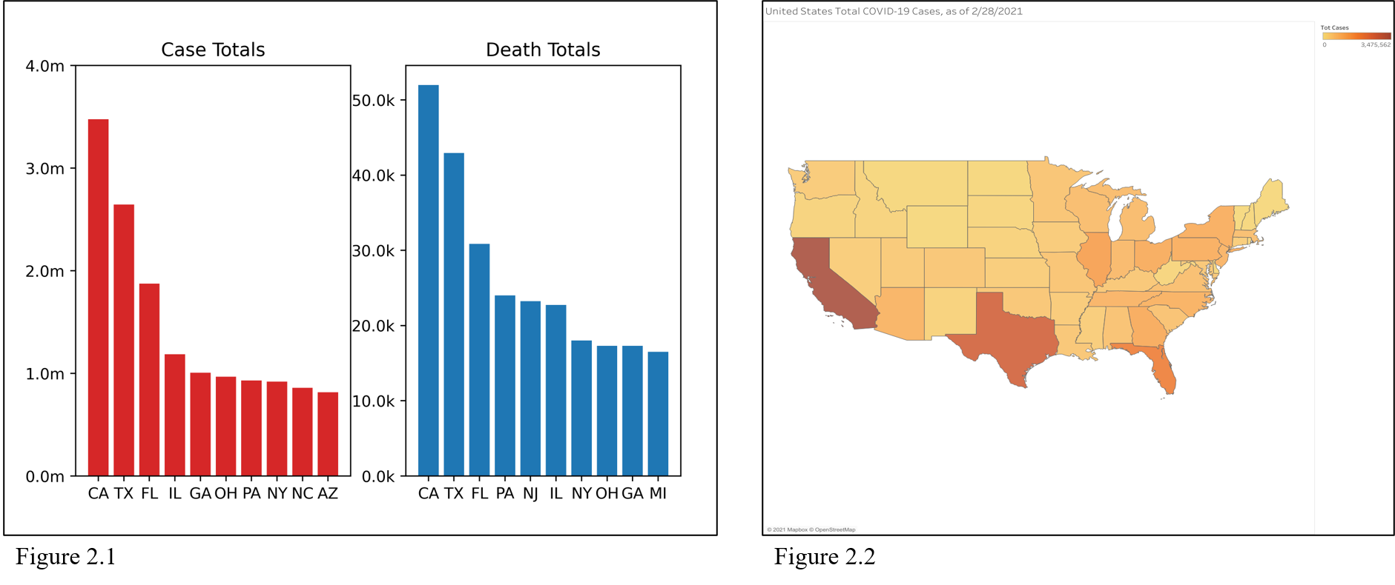
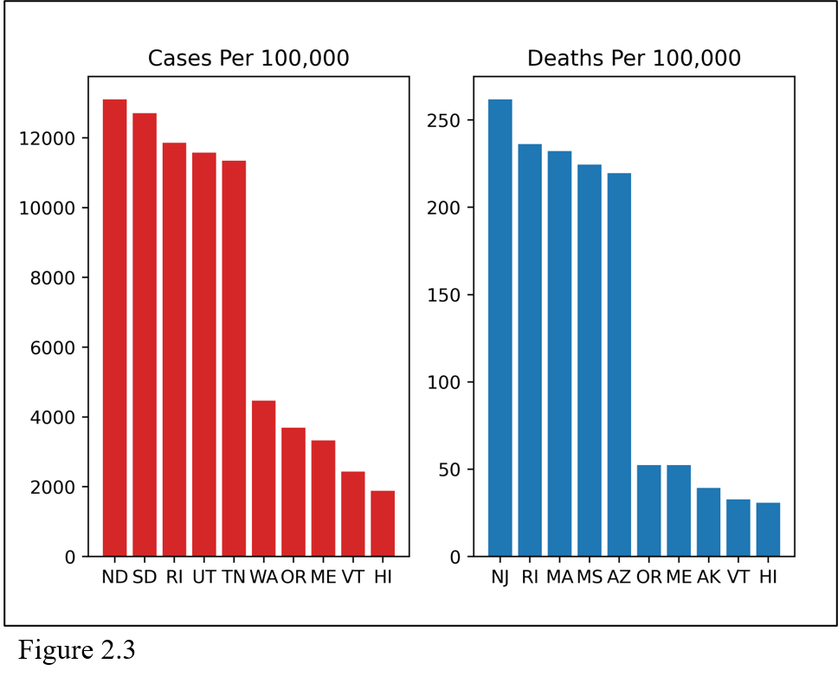
Visualizations For Case and Death Totals by State

Slide 9
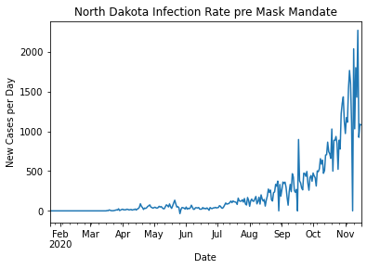
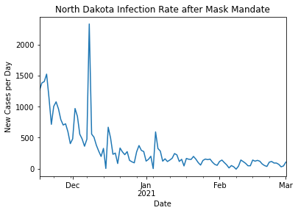
Visualizations for Pre and Post-Mask Mandate Infection Rates

Slide 10
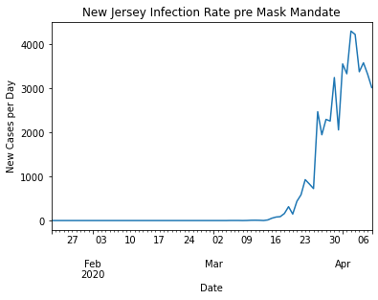
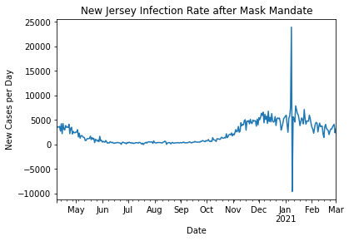
Visualizations for Pre and Post-Mask Mandate Infection Rates

Slide 11
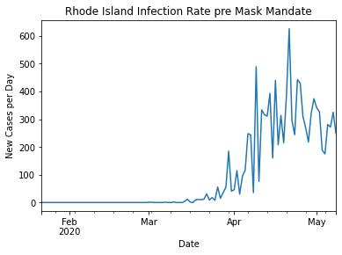
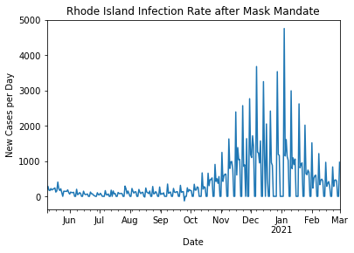
Visualizations for Pre and Post-Mask Mandate Infection Rates

Slide 12
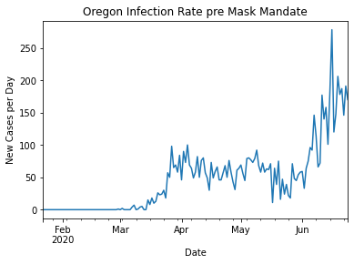

Visualizations for Pre and Post-Mask Mandate Infection Rates

Slide 13
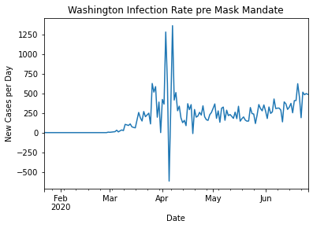
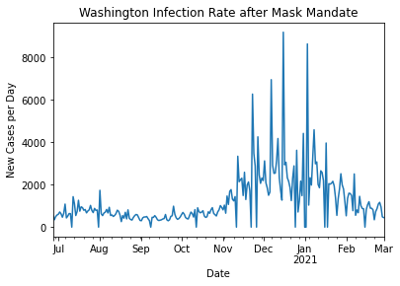
Visualizations for Pre and Post-Mask Mandate Infection Rates

Slide 14
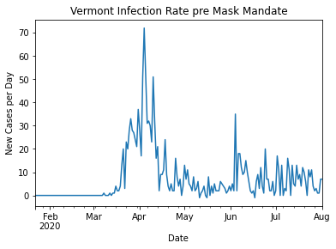
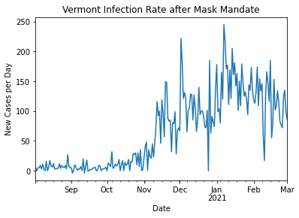
Visualizations for Pre and Post-Mask Mandate Infection Rates

Slide 15
Summary and Key Findings
Average daily infection rates did rise for most states after the mandates were impose, but the results were in line with the research of the CDC and ‘flattening the curve’
Infection rates would have likely been higher had it not been for the mask mandate
The number of cases increased with the number of COVID-19 tests performed
Notes:
The results for states that were more harshly impacted by COVID-19 displayed that mask mandates helped to slow down the rate of infection

Slide 16
Future Work
Explore if the percentage of tests that came back positive increased or decreased after state responses
Test for regression in number of cases since vaccinations started being administered
See what the long term effects of COVID-19 has on total deaths
Investigate the effects of other state responses on number of cases
Create prediction models for how COVID-19 spreads depending on the season
Notes:
predictions for when vaccinations are administered to the public.

Slide 17
Questions & Answers

